Slide 1
What’s in our food?
Joe Train

Slide 2
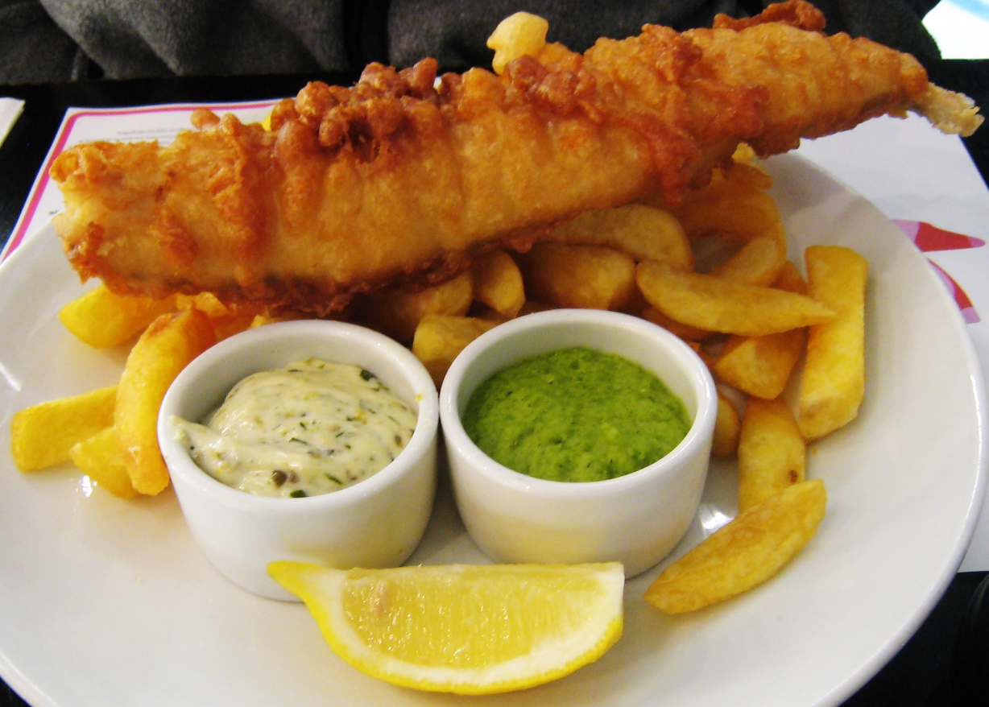
Fish and Chips
High in salt (sodium)
High in fat
High in taste!
Notes:
It’s all about balance

Slide 3
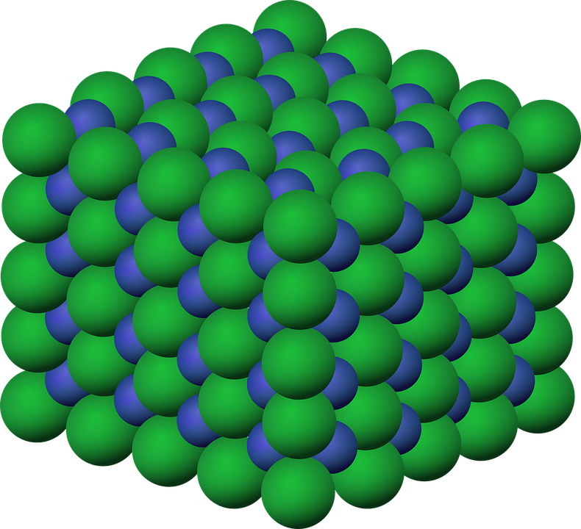
What is salt?
NaCl

Slide 4
Why is too much salt bad for you?
Why is too much salt bad for you? British Heart Foundation
https://www.youtube.com/watch?v=uM8yQNZ0x10
Notes:
British Heart Foundation, 2018. Why is too much salt bad for you? [video online]. Available at: https://www.youtube.com/watch?v=uM8yQNZ0x10 [Accessed 18/12/218]

Slide 5
How to reduce salt intake?
Shop for lower salt foods
Cook with less salt
Eating out – eat smart
  Pizza – choose veg or chicken
  Pasta – choose tomato sauce
  Chinese or Indian – choose plain rice
Check your supplements
Notes:
NHS, 2018. Tips for a lower salt diet. [online] Available at: https://www.nhs.uk/live-well/eat-well/tips-for-a-lower-salt-diet/. Accessed 18/12/2018

Slide 6
Salt - benefits and drawbacks
High blood pressure
Facilitates glucose absorption
Regulates fluid levels

Slide 7
References and Image Attribution
British Heart Foundation, 2018. Why is too much salt bad for you? [video online]. Available at: https://www.youtube.com/watch?v=uM8yQNZ0x10 [Accessed 18/12/218]
NHS, 2018. Tips for a lower salt diet. [online] Available at: https://www.nhs.uk/live-well/eat-well/tips-for-a-lower-salt-diet/. Accessed 18/12/2018
File:Fish, chips and mushy peas.jpg, Charles Haynes from Bangalore, India [CC BY-SA 2.0 (https://creativecommons.org/licenses/by-sa/2.0)], via Wikimedia Commons
File:Sodium-chloride-3D-ionic.png, Public Domain

